Slide 1
INTRODUCTION TO DATA ANALYSIS

Slide 2
CONTENT
Data preprocessing
Statistical analysis
Plots
Indexing and slicing
Cropping with aggregation
Measuring percentile
Shape distribution (skewness , kurtosis, frequency table )
Value counts
Heatmap and correlation
Slicing and minmax scaling
Dropping non-numerical column
Featuring scaling (normalizer , standardizer)
Categorical encoding

Slide 3
INTRODUCTION
The name of my CSV is "all_season_batting_card.csv" .the CSV is opted from "kaggle.com“ . the collection of the data in this CSV contains the batting card of the teams participated in IPL

Slide 4
DATA PREPROCESSING
NULL VALUES
FILLING NULL VALUE
FINDING DUPLICATES
DROPING DUPLICATES
DROPPING COLUMNS
CONVERTING RAW DATA INTO CLEANED CSV FILE

Slide 5
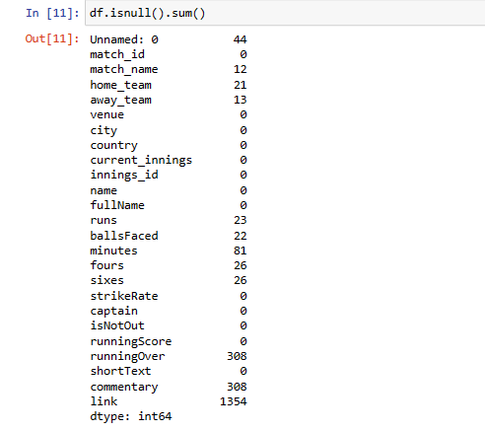
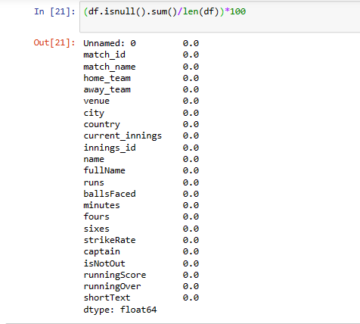
Data preprocessing
Raw data
Clean data

Slide 6
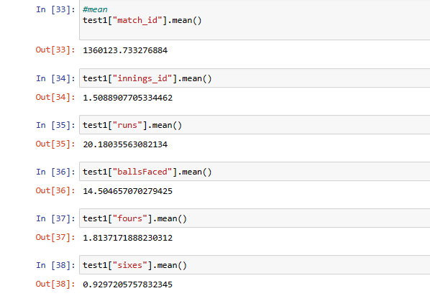
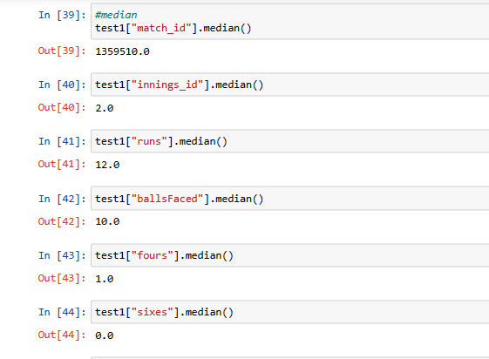
Statistical analysis
mean
median

Slide 7
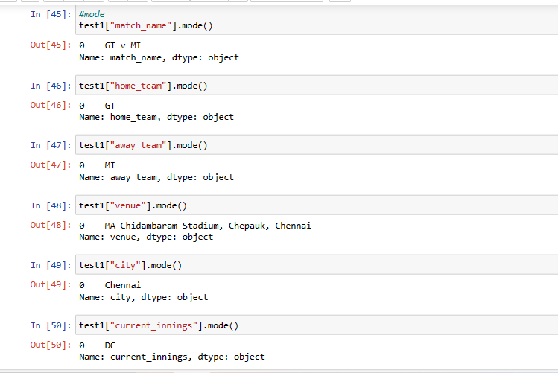
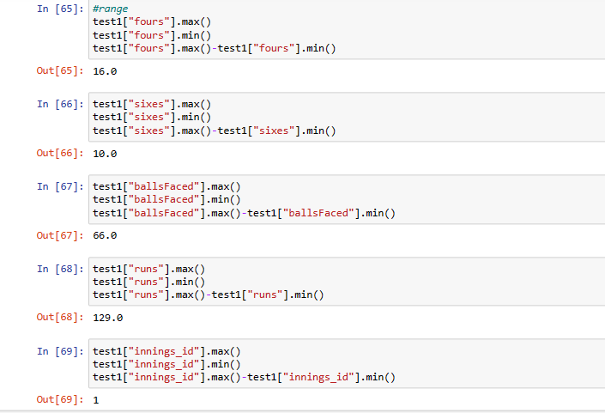
mode
range

Slide 8
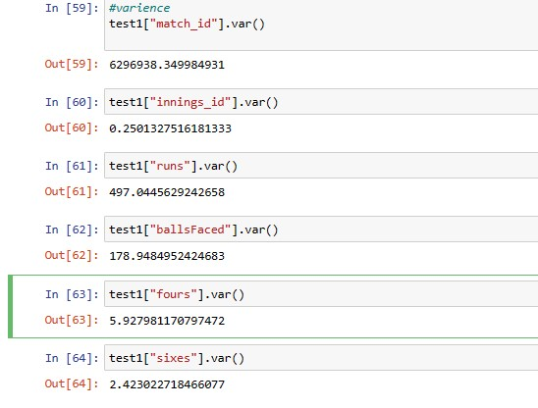
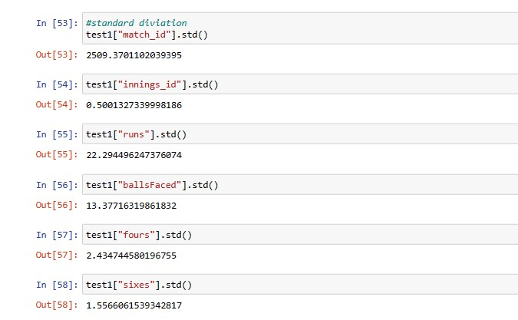
Variance
Standard Deviation

